Slide 1


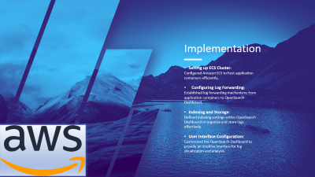
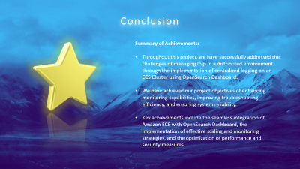


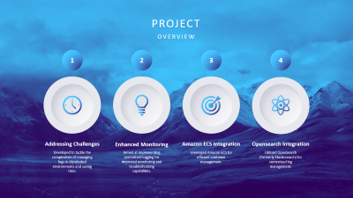
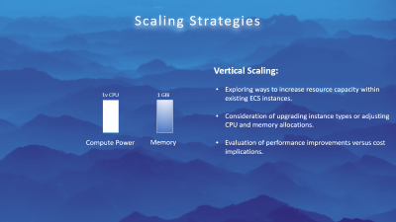

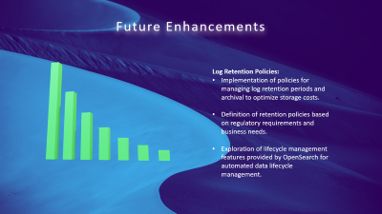

Centralized Logging of Application on ECS Cluster
A Project Presentation by Sanchit Kumar
Notes:
https://duotone.shapefactory.co/?i=-HH3cGeAC4o&f=3fc7ff&t=2c0058&q=_
https://duotone.shapefactory.co/?f=3fc7ff&t=2c0058&q=_

Slide 2
Centralized Logging of Application on ECS Cluster
A Project Presentation by Sanchit Kumar
Introduction
About Organization
Project Overview
Notes:
https://duotone.shapefactory.co/?i=-HH3cGeAC4o&f=3fc7ff&t=2c0058&q=_
https://duotone.shapefactory.co/?f=3fc7ff&t=2c0058&q=_

Slide 3
Centralized Logging of Application on ECS Cluster
A Project Presentation by Sanchit Kumar
Introduction
About Organization
Project Overview
Architecture
Implementation
Scaling Strategies
Benefits
Future Enhancements
Conclusion
Notes:
https://duotone.shapefactory.co/?i=-HH3cGeAC4o&f=3fc7ff&t=2c0058&q=_
https://duotone.shapefactory.co/?f=3fc7ff&t=2c0058&q=_

Slide 4
Centralized Logging of Application on ECS Cluster
A Project Presentation by Sanchit Kumar
Introduction
About Organization
Project Overview
Architecture
Implementation
Scaling Strategies
Benefits
Future Enhancements
Conclusion
Notes:
https://duotone.shapefactory.co/?i=-HH3cGeAC4o&f=3fc7ff&t=2c0058&q=_
https://duotone.shapefactory.co/?f=3fc7ff&t=2c0058&q=_

Slide 5
Centralized Logging of Application on ECS Cluster
A Project Presentation by Sanchit Kumar
Introduction
About Organization
Project Overview
Architecture
Implementation
Scaling Strategies
Benefits
Future Enhancements
Conclusion
Notes:
https://duotone.shapefactory.co/?i=-HH3cGeAC4o&f=3fc7ff&t=2c0058&q=_
https://duotone.shapefactory.co/?f=3fc7ff&t=2c0058&q=_

Slide 6

Centralized Logging of Application on ECS Cluster
A Project Presentation by Sanchit Kumar
Introduction
About Organization
Project Overview
Architecture
Implementation
Scaling Strategies
Benefits
Future Enhancements
Conclusion
Notes:
https://duotone.shapefactory.co/?i=-HH3cGeAC4o&f=3fc7ff&t=2c0058&q=_
https://duotone.shapefactory.co/?f=3fc7ff&t=2c0058&q=_

Slide 7

Centralized Logging of Application on ECS Cluster
A Project Presentation by Sanchit Kumar
Introduction
About Organization
Project Overview
Architecture
Implementation
Scaling Strategies
Benefits
Future Enhancements
Conclusion
Notes:
https://duotone.shapefactory.co/?i=-HH3cGeAC4o&f=3fc7ff&t=2c0058&q=_
https://duotone.shapefactory.co/?f=3fc7ff&t=2c0058&q=_

Slide 8
Introduction
Hello everyone, and thank you for joining today's presentation. My name is Sanchit, and I'm excited to share with you the project I worked on during my internship at MyOperator - Centralized Logging of Application on ECS Cluster.

Slide 9

About Organization
MyOperator is a cloud-based call management system that provides solutions such as IVR, virtual number, toll-free number, cloud EPABX, automatic call distribution, call tracking & recording, reports etc. for business

Slide 10

PROJECT
OVERVIEW
1
2
3
4
Addressing Challenges
Enhanced Monitoring
Amazon ECS Integration
Opensearch Integration
Developed to tackle the complexities of managing logs in distributed environments and saving time.
Aimed at implementing centralized logging for improved monitoring and troubleshooting capabilities.
Leveraged Amazon ECS for efficient container management.
Utilized OpenSearch (formerly Elasticsearch) for centralized log management.
Notes:
https://duotone.shapefactory.co/?i=roZgc7SXXmI&f=3fc7ff&t=2c0058&q=_

Slide 11




Architecture
ECS Cluster: Hosts application containers.
Log Forwarding: Logs forwarded to OpenSearch Dashboard for indexing and storage.
OpenSearch Dashboard: Indexes and stores logs for retrieval and analysis.
OpenSearch Dashboard: OpenSearch Dashboard serves as a user-friendly interface for log visualization and analysis.
Notes:
https://duotone.shapefactory.co/?i=phIFdC6lA4E&f=3fc7ff&t=2c0058&q=_

Slide 12

Implementation
Setting up ECS Cluster:
Configured Amazon ECS to host application containers efficiently.
Configuring Log Forwarding:
Established log forwarding mechanisms from application containers to OpenSearch Dashboard.
Indexing and Storage:
Defined indexing settings within OpenSearch Dashboard to organize and store logs effectively.
User Interface Configuration:
Customized the OpenSearch Dashboard to provide an intuitive interface for log visualization and analysis.

Slide 13

Scaling Strategies
Vertical Scaling:
Exploring ways to increase resource capacity within existing ECS instances.
Consideration of upgrading instance types or adjusting CPU and memory allocations.
Evaluation of performance improvements versus cost implications.
1v CPU
1 GBi
Compute Power
Memory

Slide 14
Scaling Strategies
3v CPU
5 GBis
Vertical Scaling:
Exploring ways to increase resource capacity within existing ECS instances.
Consideration of upgrading instance types or adjusting CPU and memory allocations.
Evaluation of performance improvements versus cost implications.
Compute Power
Memory

Slide 15
Scaling Strategies
Horizontal Scaling:
We expand our capacity by adding more ECS instances as needed, ensuring our system can handle increased demand without interruptions.
We set up automated rules based on metrics like CPU usage or incoming traffic to adjust the number of ECS instances dynamically, optimizing resource utilization.
Our load balancers are configured to evenly distribute incoming traffic across ECS instances, ensuring optimal performance and reliability during scaling events.
3v CPU
3v CPU
3v CPU
3v CPU
Compute Power

Slide 16
Scaling Strategies
Horizontal Scaling:
We expand our capacity by adding more ECS instances as needed, ensuring our system can handle increased demand without interruptions.
We set up automated rules based on metrics like CPU usage or incoming traffic to adjust the number of ECS instances dynamically, optimizing resource utilization.
Our load balancers are configured to evenly distribute incoming traffic across ECS instances, ensuring optimal performance and reliability during scaling events.
3v CPU
3v CPU
3v CPU
3v CPU
Compute Power
Notes:
zoom

Slide 17


Benefits
Implementing centralized logging offered several benefits:
Improved monitoring and troubleshooting capabilities.
Centralized access to logs for analysis and auditing.
Scalability and flexibility to accommodate growing log volumes.
Notes:
https://storyset.com/illustration/business-plan/bro
https://duotone.shapefactory.co/?i=c65n6pgkXkI&f=3fc7ff&t=2c0058&q=_

Slide 18


Future Enhancements
Log Retention Policies:
Implementation of policies for managing log retention periods and archival to optimize storage costs.
Definition of retention policies based on regulatory requirements and business needs.
Exploration of lifecycle management features provided by OpenSearch for automated data lifecycle management.
Notes:
https://storyset.com/illustration/business-plan/bro
https://duotone.shapefactory.co/?i=c65n6pgkXkI&f=3fc7ff&t=2c0058&q=_

Slide 19


Future Enhancements
Log Retention Policies:
Implementation of policies for managing log retention periods and archival to optimize storage costs.
Definition of retention policies based on regulatory requirements and business needs.
Exploration of lifecycle management features provided by OpenSearch for automated data lifecycle management.
Notes:
https://storyset.com/illustration/business-plan/bro
https://duotone.shapefactory.co/?i=c65n6pgkXkI&f=3fc7ff&t=2c0058&q=_

Slide 20


Conclusion
Summary of Achievements:
Throughout this project, we have successfully addressed the challenges of managing logs in a distributed environment through the implementation of centralized logging on an ECS Cluster using OpenSearch Dashboard.
We have achieved our project objectives of enhancing monitoring capabilities, improving troubleshooting efficiency, and ensuring system reliability.
Key achievements include the seamless integration of Amazon ECS with OpenSearch Dashboard, the implementation of effective scaling and monitoring strategies, and the optimization of performance and security measures.

Slide 21

Question & Answers
Opening the floor for any additional questions or discussions.

